Slide 1
mov is Turing-complete
Authored by: Stephen Dolan (PhD Candidate)
19 July 2013
Computer Laboratory, University of Cambridge
http://www.cl.cam.ac.uk/~sd601/papers/mov.pdf
Practical implementation by: Chris Domas
Papers We Love #14 (26 Oct 2015)
By: Yeo Kheng Meng (yeokm1@gmail.com)
https://github.com/yeokm1/mov-is-turing-complete

Slide 2
This presentation is best viewed with the animations.

Slide 3

How did I know of this paper?
Hacker News: June 21
Link to: https://github.com/xoreaxeaxeax/movfuscator
Inspired by mov is Turing-complete

Slide 4
Schedule of presentation
2 parts in this presentation
Purely theoretical talk about the paper (~40mins)
How things work in practice? (~15 mins)
  Short demo using Chris Domas implementation
  Challenges of a practical implementation

Slide 5
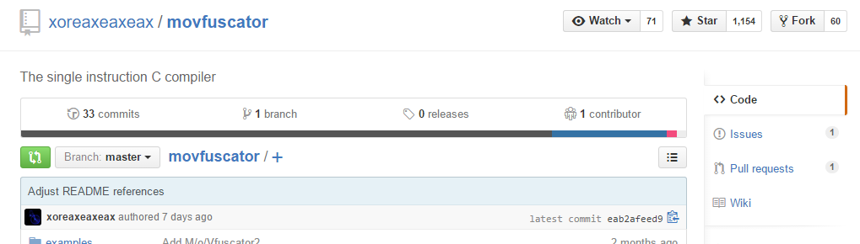
Motivation
x86 instruction set is bloated
  500 – 1000 instructions depending on sources
Is it possible to reduce everything to one instruction?
Initially a thought experiment by Stephen Dolan
  Actual implementation by Chris Domas’s Movfuscator
  https://github.com/xoreaxeaxeax/movfuscator

Slide 6
Some disclaimers by the paper
Not purely mov-only
  A single “jmp” instruction is used to loop back to the beginning
  Solved by Chris Domas’s implementation
Invalid memory address 0 to halt execution
No other forms of circumventing the rules
  No self-modifying code
  No runtime code generation

Slide 7
Scope of the problem
Title: mov is Turing-complete
What is a Turing machine?
What it means to be Turing-complete?
What is “mov”?
What it takes for “mov” to be Turing Complete?

Slide 8
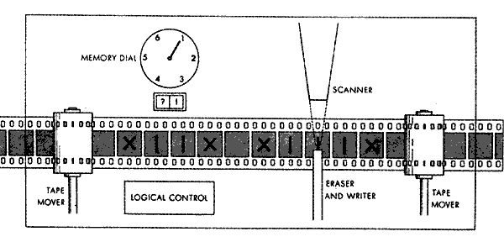
What is a Turing machine?
Theoretical Finite State Machine (FSM) model
Characteristics
Operates on tape Finite length Divided into cells Each cell contains symbol of finite alphabet
Head (Scanner) Reads/Writes to cells Can move left/right to next cell
State register Remember current state of FSM
Transition state table Lookup next state & symbol, tape direction based on current state & symbol
Logic Process Read current symbol from tape Consult transition state table Modify the symbol Move the head left/right/stay Stay/Go to another state based on state table
Source: http://stackoverflow.com/a/236022

Slide 9
What it means to be Turing-complete?
A programming language must be able to compute any problem a Turing machine can.
-> Have the same characteristics as a Turing machine
Characteristics
Operates on tape Finite length Divided into cells Each cell contains symbol of finite alphabet
Head (Scanner) Reads/Writes to cells Can move left/right to next cell
State register Remember current state of FSM
Transition state table Lookup next state & symbol, tape direction based on current state & symbol
Logic Process Read current symbol from tape Consult transition state table Modify the symbol Move the head left/right/stay Stay/Go to another state based on state table

Slide 10
What is mov?
x86 assembly instruction to move contents from one location to another.
General syntax : mov destination, source
  Copies (not cut) from source to destination
Comes in 5 forms
Syntax | Explanation
mov R_{dest}, R_{src} | Register <- Register
mov R_{dest}, c | Register <- Constant
mov [R_{src} + R_{offset}], c | Memory <- Constant
mov R_{dest}, [R_{src} + R_{offset}] | Register <- Memory
mov [R_{dest} + R_{offset}], R_{src} | Memory <- Register
Square[x] brackets means memory access at location index specified by x.

Slide 11
4. What it takes for “mov” to be Turing Complete?
Turing Machine Characteristics | In context of mov-only instruction
Operates on tape Finite length Divided into cells Each cell contains symbol of finite alphabet | ???
Head (Scanner) Reads/Writes to cells Can move left/right to next cell | Read/Write to memory at multiple locations mov
State register Remember current state of FSM | Just reserve one register to remember state
Transition state table Lookup next state & symbol, tape direction based on current state & symbol | ????
Logic Process Read current symbol from tape Consult transition state table Modify the symbol Move the head left/right/stay Stay/Go to another state based on state table | ???
✓
✓

Slide 12
What we have to do?
Unfulfilled Turing characteristics
Operates on tape Finite length Divided into cells Each cell contains symbol of finite alphabet
Transition state table Lookup next state & symbol, tape direction based on current state & symbol
Logic Process Read current symbol from tape Consult transition state table Modify the symbol Move the head left/right/stay Stay/Go to another state based on state table

Slide 13
Building our Turing machine

Slide 14
Designing the tape
Unfulfilled Turing characteristic
Operates on tape Finite length Divided into cells Each cell contains symbol of finite alphabet
Current symbol
Left/Right stack to hold everything
Each symbol cell holds 2 things
  Pointer to symbol value
  Pointer to next cell
<= Move tape to the left <=
Current symbol goes left
Left Stack
Right Stack
Current Symbol
| Null
Current Symbol
| Null
Left Symbol 0
| Point to Left symbol 1
Left Symbol 1
| Point to Left symbol 2
Right Symbol 1
| Point to Right symbol 2
Left Symbol 2
| Point to Left symbol 3
Right Symbol 2
| Point to Right symbol 3
Left Symbol 3
| Point to Left symbol 4
Right Symbol 3
| Point to Right symbol 4
Left Symbol 4
| Point to Left symbol 5
Right Symbol 4
| Point to Right symbol 5
:
:

Slide 15
Designing the tape
Unfulfilled Turing characteristic
Operates on tape Finite length Divided into cells Each cell contains symbol of finite alphabet
Current symbol
Left/Right stack to hold everything
Each symbol cell holds 2 things
  Pointer to symbol value
  Pointer to next cell
Left Stack
Right Stack
=> Move tape right =>
Current symbol goes right
Current Symbol
| Null
Current Symbol
| Null
Right Symbol 0
| Point to Right symbol 1
Left Symbol 1
| Point to Left symbol 2
Right Symbol 1
| Point to Right symbol 2
Left Symbol 2
| Point to Left symbol 3
Right Symbol 2
| Point to Right symbol 3
Left Symbol 3
| Point to Left symbol 4
Right Symbol 3
| Point to Right symbol 4
Left Symbol 4
| Point to Left symbol 5
Right Symbol 4
| Point to Right symbol 5
:
:

Slide 16
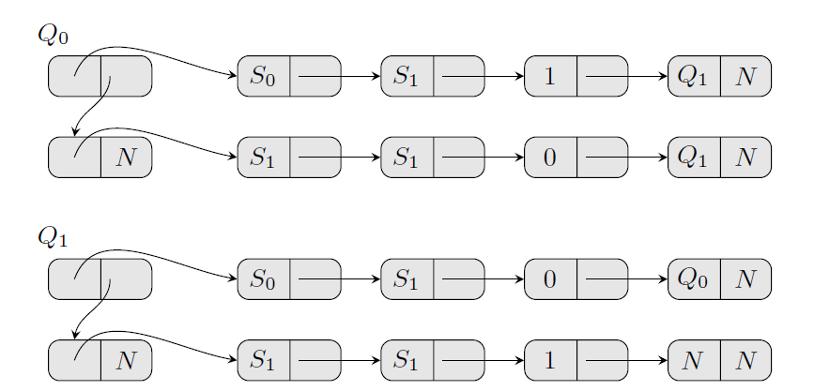
Designing the transition state table
Unfulfilled Turing characteristic
Transition state table Lookup next state & symbol, tape direction based on current state & symbol
Table of linked cells, easier for mov to use
Each cell contains a value and points to next cell
N: Dummy pointer indicating end of list
Current State Q_{x}
Points to Trigger symbol of possible transition
| Point to alternative transition cell
Trigger symbol
| Point to new symbol cell
New symbol
| Point to direction cell
Direction
| Point to next state cell
Next State
| End of list
State Q₀
State Q₁

Slide 17
Now to the mov stuff

Slide 18
Equality checking (Problem)
We want to check if R_{i} == R_{j}?
Output result of comparison 0/1 register R_{k}

Slide 19
Equality checking (Example 1)
Assume both are equal at R_{i} = R_{j} = 6
We want to check if R_{i} == R_{j}.
Expected output at register R_{k} = 1
mov [R_{i}], 0 -> mov [6], 0
mov [R_{j}], 1 -> mov [6], 1
mov R_{k}, [R_{i}] -> mov R_{k}, [6]
Register | Contents
R_{k} (Result)
R_{i} | 6
R_{j} | 6
… | …
1
Memory address range of the machine
Mem Address | 0 | 1 | 2 | 3 | 4 | 5 | 6 | 7 | 8
Contents | - | - | - | - | - | - |  | - | -
-
1
0

Slide 20
Equality checking (Example 2)
Assume both are NOT equal at R_{i} = 5, R_{j} = 2
We want to check if R_{i} == R_{j}.
Expected output at register R_{k} = 0
mov [R_{i}], 0 -> mov [5], 0
mov [R_{j}], 1 -> mov [2], 1
mov R_{k}, [R_{i}] -> mov R_{k}, [5]
Register | Contents
R_{k} (Result)
R_{i} | 5
R_{j} | 2
… | …
0
Memory address range of the machine
Mem Address | 0 | 1 | 2 | 3 | 4 | 5 | 6 | 7 | 8
Contents | - | - |  | - | - |  | - | - | -
-
1
-
0

Slide 21
Value selection
Given R_{c} being 0 or 1, pick either value R_{a} or R_{b}
Put result in R_{d}
We can use R_{lookup} as start index of “lookup-table”
mov [R_{lookup}], R_{a}
mov [R_{lookup} + 1], R_{b}
mov R_{d}, [R_{lookup} + R_{c}] // R_{c} is 0 or 1
If R_{c} == 0 : R_{d} = R_{a}
Else: R_{d} = R_{b}
Lookup table
Lookup Addresses | R_{lookup} | R_{lookup} + 1
Contents
-
R_{a}
-
R_{b}

Slide 22
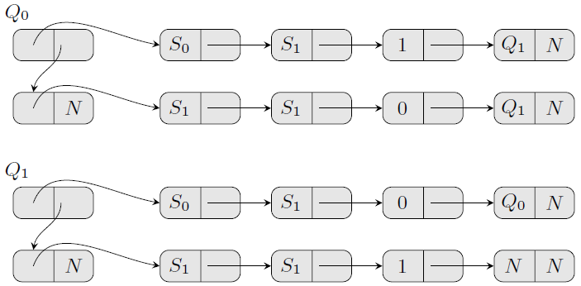
Our architecture so far
Tape (Left/Right Stack)
Transition State Table
Current Symbol
| Null
Current
State
Trigger
Symbol
New
Symbol
Tape
Direction
Next
State
Left Symbol 1
| Point to Left symbol 2
Right Symbol 1
| Point to Right symbol 2
Left Symbol 2
| Point to Left symbol 3
Right Symbol 2
| Point to Right symbol 3
Left Symbol 3
| Point to Left symbol 4
Right Symbol 3
| Point to Right symbol 4
Lookup table
Mem Address | LOOKUP | LOOKUP + 1
Contents
Setting aside some registers
Register | Purpose
SYMBOL | Pointer to current symbol read from tape
LEFT | Pointer to first symbol on the left stack
RIGHT | Pointer to first symbol on the right stack
CTRANS | Pointer to transition to be tested (First word of transition points to trigger symbol)
LOOKUP | Points to lookup table (scratch space)

Slide 23
Logic Process
Logic Process
Read current symbol from tape Consult transition state table Modify the symbol Move the head left/right/stay Stay/Go to another state based on state table
Tape (Left/Right Stack)
Current Symbol
| Null
Transition State Table
Left Symbol 1
| Point to Left symbol 2
Right Symbol 1
| Point to Right symbol 2
Current
State
Trigger
Symbol
New
Symbol
Tape
Direction
Next
State
Left Symbol 2
| Point to Left symbol 3
Right Symbol 2
| Point to Right symbol 3
Left Symbol 3
| Point to Left symbol 4
Right Symbol 3
| Point to Right symbol 4
Lookup table
Mem Address | LOOKUP | LOOKUP + 1
Contents
Register | Purpose/Contents
SYMBOL | Pointer to current symbol read from tape
LEFT | Pointer to first symbol on the left stack
RIGHT | Pointer to first symbol on the right stack
CTRANS | Pointer to transition to be tested
LOOKUP | Points to lookup table (scratch space)
… | …
… | …
… | …
… | …

Slide 24
Logic Process (Step: 1 & 2)
Logic Process
Read current symbol from tape Consult transition state table Modify the symbol Move the head left/right/stay Stay/Go to another state based on state table
Tape (Left/Right Stack)
Current Symbol
| Null
Transition State Table
Left Symbol 1
| Point to Left symbol 2
Right Symbol 1
| Point to Right symbol 2
Current
State
Trigger
Symbol
New
Symbol
Tape
Direction
Next
State
Left Symbol 2
| Point to Left symbol 3
Right Symbol 2
| Point to Right symbol 3
Left Symbol 3
| Point to Left symbol 4
Right Symbol 3
| Point to Right symbol 4
Consult transition state table
Retrieve current symbol, compare with trigger symbol
Extra temporary registers X, Y & M
mov X, [SYMBOL] // get current symbol
mov Y, [CTRANS] // get pointer to trigger symbol
mov Y, [Y] // get trigger symbol
mov [X], 0 //Put 0 inside memory using Y as index
mov [Y], 1 //Put 1 inside memory using X as index
mov M, [X] //M gets 0/1 depending on equality
Lookup table
Mem Address | LOOKUP | LOOKUP + 1
Contents
Register | Purpose/Contents
SYMBOL | Pointer to current symbol read from tape
LEFT | Pointer to first symbol on the left stack
RIGHT | Pointer to first symbol on the right stack
CTRANS | Pointer to transition to be tested
LOOKUP | Points to lookup table (scratch space)
… | …
X (Temp)
Current symbol
Y (Temp)
Pointer to trigger symbol
Trigger symbol
M (Result)
1 if equal, 0 otherwise

Slide 25
Logic Process (Step: 3)
Logic Process
Read current symbol from tape Consult transition state table Modify the symbol Move the head left/right/stay Stay/Go to another state based on state table
Tape (Left/Right Stack)
Current Symbol
| Null
Transition State Table
Left Symbol 1
| Point to Left symbol 2
Right Symbol 1
| Point to Right symbol 2
Current
State
Trigger
Symbol
New
Symbol
Tape
Direction
Next
State
Left Symbol 2
| Point to Left symbol 3
Right Symbol 2
| Point to Right symbol 3
Left Symbol 3
| Point to Left symbol 4
Right Symbol 3
| Point to Right symbol 4
Modify the symbol
M from Step 2. Extra temporary registers X, Y, Z.
Choose between current/new symbol -> write symbol
mov X, [CTRANS] // get pointer to trigger symbol
mov X, [X + 1] // Load pointer to new symbol by skipping trigger symbol
mov X, [X] // load new symbol
mov Y, [SYMBOL] // load old symbol
mov [LOOKUP], Y //determine new symbol == X/Y?
mov [LOOKUP + 1], X
mov Z, [LOOKUP + M]
mov [SYMBOL], Z //write the selected symbol back
Lookup table
Mem Address | LOOKUP | LOOKUP + 1
Contents
Y
X
Register | Purpose/Contents
SYMBOL
LEFT | Pointer to first symbol on the left stack
RIGHT | Pointer to first symbol on the right stack
CTRANS | Pointer to transition to be tested
LOOKUP | Points to lookup table (scratch space)
Pointer to current symbol read from tape
X (Temp)
New symbol
Pointer to new symbol
Pointer to trigger symbol
Y (Temp)
Old symbol
Z (Temp)
Selected new symbol value from X or Y
M (Match)
Result 0/1 of transition comparison from Step 2

Slide 26
Logic Process (Step: 4.1)
Logic Process
Read current symbol from tape Consult transition state table Modify the symbol Move the head left/right/stay Stay/Go to another state based on state table
Tape (Left/Right Stack)
Current Symbol
| Null
Transition State Table
Left Symbol 1
| Point to Left symbol 2
Right Symbol 1
| Point to Right symbol 2
Current
State
Trigger
Symbol
New
Symbol
Tape
Direction
Next
State
Left Symbol 2
| Point to Left symbol 3
Right Symbol 2
| Point to Right symbol 3
Left Symbol 3
| Point to Left symbol 4
Right Symbol 3
| Point to Right symbol 4
Load tape direction of transition, regardless of transition matching
M from Step 2. Result register D to choose direction.
mov D, [CTRANS] // get pointer to trigger symbol
mov D, [D+1] // load new symbol pointer
mov D, [D+1] //load direction pointer
mov D, [D] // load direction
Lookup table
Mem Address | LOOKUP | LOOKUP + 1
Contents
Register | Purpose/Contents
SYMBOL
LEFT | Pointer to first symbol on the left stack
RIGHT | Pointer to first symbol on the right stack
CTRANS | Pointer to transition to be tested
LOOKUP | Points to lookup table (scratch space)
Pointer to current symbol read from tape
M (Match)
Result 0/1 of transition comparison from Step 2
Pointer to direction
Pointer to new symbol
D (Result)
Pointer to trigger symbol
Direction value 0/1

Slide 27
Logic Process (Step: 4.2)
Logic Process
Read current symbol from tape Consult transition state table Modify the symbol Move the head left/right/stay Stay/Go to another state based on state table
Tape (Left/Right Stack)
Current Symbol
| Point to Left/Right symbol 1
Current Symbol
| Null
Transition State Table
Left Symbol 1
| Point to Left symbol 2
Right Symbol 1
| Point to Right symbol 2
Current
State
Trigger
Symbol
New
Symbol
Tape
Direction
Next
State
Left Symbol 2
| Point to Left symbol 3
Right Symbol 2
| Point to Right symbol 3
Left Symbol 3
| Point to Left symbol 4
Right Symbol 3
| Point to Right symbol 4
Depending on tape direction, push current symbol cell into stack
M from Step 2, D from Step 4.1, Temporary Register X.
//Get the first cell from left/right stack as next cell for current symbol
mov [LOOKUP], LEFT
mov [LOOKUP + 1], RIGHT
mov X, [LOOKUP + D]
mov [SYMBOL + 1], X //Point the current symbol’s next pointer to the next cell
//Select new value for first symbol LEFT
mov [LOOKUP], SYMBOL
mov [LOOKUP + 1], LEFT
mov LEFT, [LOOKUP + D]
//Select new value for first symbol RIGHT
mov [LOOKUP], RIGHT
mov [LOOKUP +1] , SYMBOL
mov RIGHT, [LOOKUP + D]
Lookup table
Mem Address | LOOKUP | LOOKUP + 1
Contents
Right
Symbol
Symbol
Left
Left
Right
Register | Purpose/Contents
SYMBOL
LEFT | Pointer to first symbol on the left stack
RIGHT | Pointer to first symbol on the right stack
CTRANS | Pointer to transition to be tested
LOOKUP | Points to lookup table (scratch space)
Pointer to current symbol read from tape
M (Match)
Result 0/1 of transition comparison from Step 2
D (Result)
Direction value 0/1 from Step 4.1
X (Temp)
Pointer to first cell of left/right stack

Slide 28
Logic Process (Step: 4.3)
Logic Process
Read current symbol from tape Consult transition state table Modify the symbol Move the head left/right/stay Stay/Go to another state based on state table
Tape (Left/Right Stack)
Current Symbol
| Point to Left/Right symbol 1
Current Symbol
| Null
Transition State Table
Left Symbol 1
| Point to Left symbol 2
Right Symbol 1
| Point to Right symbol 2
Current
State
Trigger
Symbol
New
Symbol
Tape
Direction
Next
State
Left Symbol 2
| Point to Left symbol 3
Right Symbol 2
| Point to Right symbol 3
Left Symbol 3
| Point to Left symbol 4
Right Symbol 3
| Point to Right symbol 4
Preparation to pop stack
Invert Register D if no movement is actually required i.e. M == 0
M from Step 2, D from Step 4.1, Temporary Register X.
//Put negation of D into X
mov [LOOKUP], 1 //Reverse order of selection
mov [LOOKUP + 1], 0 //Reverse order of selection
mov X, [LOOKUP + D]
//Use M to select between D or X (D-negation)
mov [LOOKUP], X
mov [LOOKUP +1], D
mov D, [LOOKUP + M]
Lookup table
Mem Address | LOOKUP | LOOKUP + 1
Contents
1
0
X (D-negation)
D
Register | Purpose/Contents
SYMBOL
LEFT | Pointer to first symbol on the left stack
RIGHT | Pointer to first symbol on the right stack
CTRANS | Pointer to transition to be tested
LOOKUP | Points to lookup table (scratch space)
Pointer to current symbol read from tape
M (Match)
Result 0/1 of transition comparison from Step 2
Direction value 0/1 from Step 4.1
D (Result)
Direction value to determine pop decision
X (Temp)
Negation of D

Slide 29
Logic Process (Step: 4.4)
Logic Process
Read current symbol from tape Consult transition state table Modify the symbol Move the head left/right/stay Stay/Go to another state based on state table
Tape (Left/Right Stack)
Current Symbol
| Point to Left/Right symbol 1
Left symbol 0
| Point to Left symbol 1
Right symbol 0
| Point to Right symbol 1
Transition State Table
Left Symbol 1
| Point to Left symbol 2
Right Symbol 1
| Point to Right symbol 2
Current
State
Trigger
Symbol
New
Symbol
Tape
Direction
Next
State
Left Symbol 2
| Point to Left symbol 3
Right Symbol 2
| Point to Right symbol 3
Left Symbol 3
| Point to Left symbol 4
Right Symbol 3
| Point to Right symbol 4
We need a new current symbol, pop a cell from one side based on D
D from Step 4.3, Temporary Register X.
//Select new value for SYMBOL from either LEFT or RIGHT stack
mov [LOOKUP], RIGHT
mov [LOOKUP + 1], LEFT
mov SYMBOL, [LOOKUP + D]
mov X, [SYMBOL + 1] //Find new top of stack
//Find new top value for LEFT
mov [LOOKUP], LEFT
mov [LOOKUP + 1], X
mov LEFT, [LOOKUP + D] //If D == 1, we just popped the left stack, set X to LEFT
//Find new value for RIGHT
mov [LOOKUP], X
mov [LOOKUP + 1], RIGHT
mov RIGHT, [LOOKUP + D] //If D == 0, we just popped the right stack, set X to RIGHT
Lookup table
Mem Address | LOOKUP | LOOKUP + 1
Contents
Left
X
Right
Left
X
Right
Register | Purpose/Contents
SYMBOL
LEFT | Pointer to first symbol on the left stack
RIGHT | Pointer to first symbol on the right stack
CTRANS | Pointer to transition to be tested
LOOKUP | Points to lookup table (scratch space)
Pointer to current symbol read from tape
D (Result)
Direction value to determine pop decision
X (Temp)
Top value of stack we popped from

Slide 30
Logic Process (Step: 5)
Logic Process
Read current symbol from tape Consult transition state table Modify the symbol Move the head left/right/stay Stay/Go to another state based on state table
Tape (Left/Right Stack)
Current Symbol
| Null
Transition State Table
Left Symbol 1
| Point to Left symbol 2
Right Symbol 1
| Point to Right symbol 2
Current
State
Trigger
Symbol
New
Symbol
Tape
Direction
Next
State
Left Symbol 2
| Point to Left symbol 3
Right Symbol 2
| Point to Right symbol 3
Left Symbol 3
| Point to Left symbol 4
Right Symbol 3
| Point to Right symbol 4
Find next transition
M from Step 2, Temporary Registers X & Y.
If current transition matches, go to first transition of next state,
else, go to next transition of current state
//get next transition of current state
mov X, [CTRANS + 1]
//get first transition of next state
mov Y, [CTRANS] //get current transition
mov Y, [Y + 1] //skip trigger symbol
mov Y, [Y + 1] //skip new symbol
mov Y, [Y + 1] //skip direction
mov Y, [Y] //Select next transition
mov [LOOKUP], X
mov [LOOKUP + 1], Y
mov CTRANS, [LOOKUP + M]
Lookup table
Mem Address | LOOKUP | LOOKUP + 1
Contents
X
Y
Register | Purpose/Contents
SYMBOL
LEFT | Pointer to first symbol on the left stack
RIGHT | Pointer to first symbol on the right stack
CTRANS | Pointer to transition to be tested
LOOKUP | Points to lookup table (scratch space)
Pointer to current symbol read from tape
M (Match)
Result 0/1 of transition comparison from Step 2
X (Temp)
Pointer to next transition of current state
Y (Temp)
Pointer to first transition of next state

Slide 31
Logic Process (Extra Step 6)
Halting the machine
Logic Process
Read current symbol from tape Consult transition state table Modify the symbol Move the head left/right/stay Stay/Go to another state based on state table
Tape (Left/Right Stack)
Current Symbol
| Null
Transition State Table
Left Symbol 1
| Point to Left symbol 2
Right Symbol 1
| Point to Right symbol 2
Current
State
Trigger
Symbol
New
Symbol
Tape
Direction
Next
State
Left Symbol 2
| Point to Left symbol 3
Right Symbol 2
| Point to Right symbol 3
Left Symbol 3
| Point to Left symbol 4
Right Symbol 3
| Point to Right symbol 4
Halt machine if CTRANS is N
Assume load from address 0 halts machine
Temporary register H, X
//Set H = 1 if CTRANS is N (end of state list or no outgoing transitions)
mov [N], 0
mov [CTRANS], 1
mov H, [N]
//select between 0 and N depending on H value
mov [LOOKUP], 0
mov [LOOKUP + 1], N
mov X, [LOOKUP + H]
mov X, [X] // load from 0 or end of list. Program will terminate here if X is 0
jmp start //Go back to top of program
Lookup table
Mem Address | LOOKUP | LOOKUP + 1
Contents
0
N
Register | Purpose/Contents
SYMBOL
LEFT | Pointer to first symbol on the left stack
RIGHT | Pointer to first symbol on the right stack
CTRANS | Pointer to transition to be tested
LOOKUP | Points to lookup table (scratch space)
Pointer to current symbol read from tape
H (Temp)
Whether to halt? 0:No, 1:Yes
X (Temp)
To test whether machine to halt

Slide 32
Practical time

Slide 33
Chris Domas’s movfuscator
https://github.com/xoreaxeaxeax/movfuscator
C compiler that compiles into mov instructions
Uses LCC as frontend

Slide 34
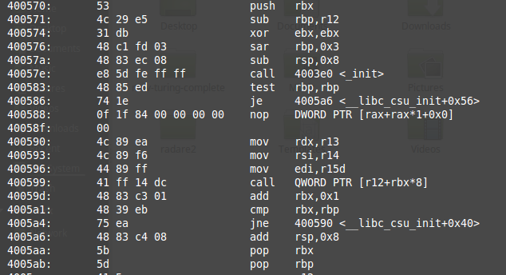
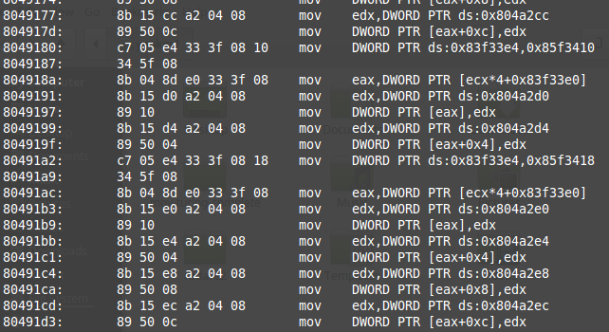
Why is it called movfuscator?
To defeat reverse-engineering
Disassembled output:
GCC
movfuscator

Slide 35
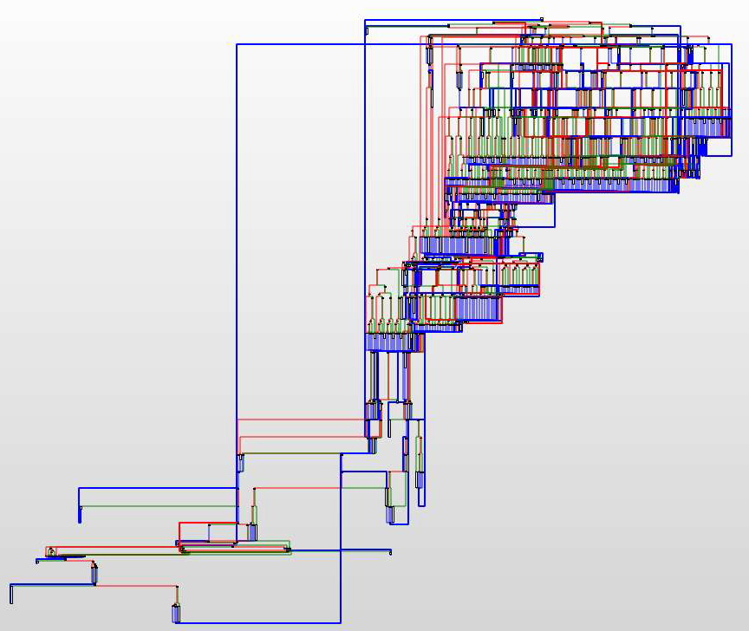
Why is called movfuscator?
Control flow graph generated by disassemblers
mov-only
Typical
vs
Source Slide 109-110: https://github.com/xoreaxeaxeax/movfuscator/blob/master/slides/domas_2015_the_movfuscator.pdf

Slide 36
Quick demo

Slide 37
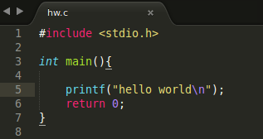
Our hello world program
 | GCC (hwgcc.sh) | Movcc (hwmov.sh)
Compile program and run | gcc -g hw.c -o hw-gcc.out && ./hw-gcc.out | movcc -g hw.c -o hw-movcc.out && ./hw-movcc.out
Disassemble program & output to file | objdump -M intel -S -l hw-gcc.out > hw-gcc.asm | objdump -M intel -S -l hw-movcc.out > hw-movcc.asm
Open in sublime | subl hw-gcc.asm | subl hw-movcc.asm

Slide 38
Enhancement: Remove jmp at the end
mov cs, ax //Illegal mov instruction cannot modify code segment register
Solution concept:
  OS raises SIGILL (illegal instruction signal)
  Code to capture SIGILL signal
  Call sigaction() to tell OS we have handled the instruction
  Reload the stack (Go back to top)
Source Slide 101: https://github.com/xoreaxeaxeax/movfuscator/blob/master/slides/domas_2015_the_movfuscator.pdf

Slide 39
Problem 1 : Branching
Issue: All mov instructions always execute
Use dummy data if mov instructions must be ignored
start:
0x1000 mov …
0x1004 mov …
0x1008 mov …
0x100c mov …
0x1010 mov …
0x1014 mov …
0x1018 mov …
0x101c mov …
0x1020 mov …
0x1024 mov …
0x1028 mov …
0x102c mov …
0x1030 jmp start
Destination: 0x1010
<- to here
Step 4: Check if this block is meant to be executed
Step 5: Switch to real data and continue execution
<- Branch from here
Step 1: Store address 0x1010 somewhere
Step 2: Switch memory pointers to dummy data
Step 3: Proceed and loop around if needed

Slide 40
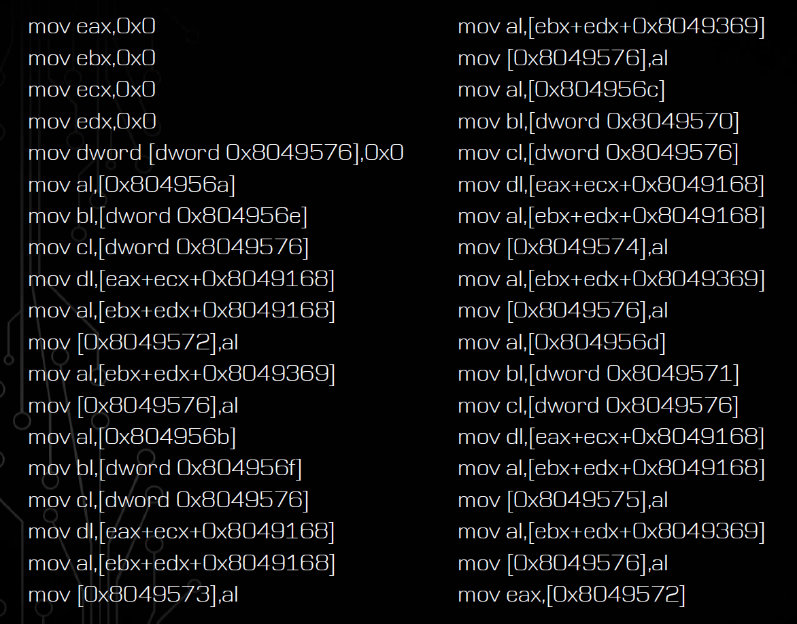
Problem 2: Arithmetic
For eg: add32
Macro expansion
Source Slide 133: https://github.com/xoreaxeaxeax/movfuscator/blob/master/slides/domas_2015_the_movfuscator.pdf

Slide 41
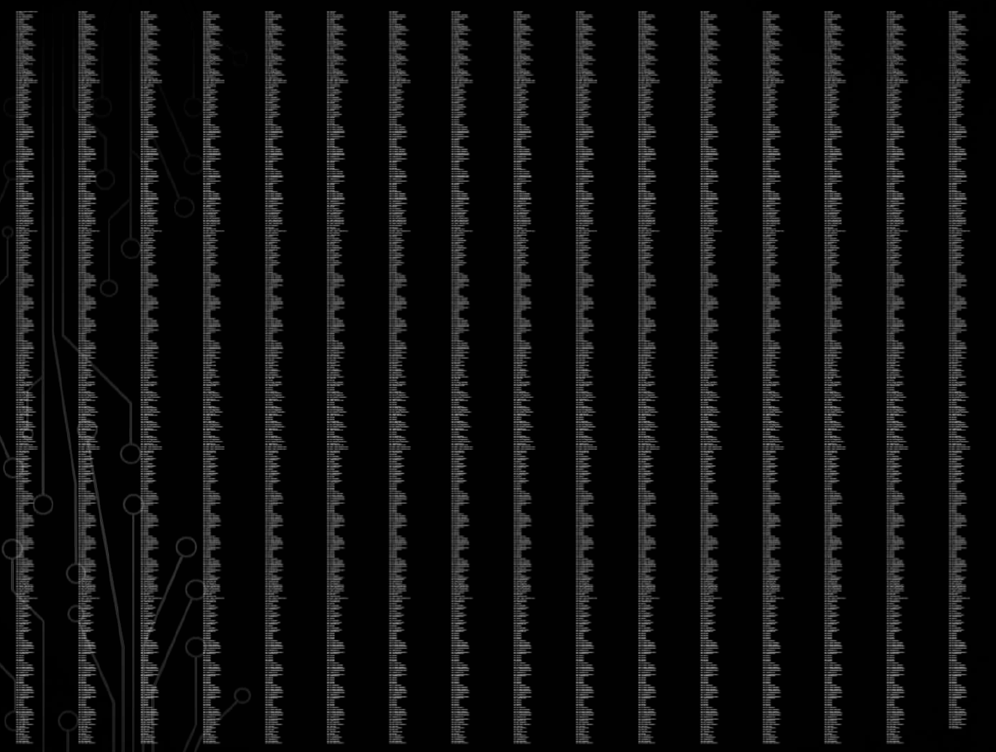
Problem 2: Arithmetic
For division
>7000 mov instructions!!! (with the help of macros)
Source Slide 141: https://github.com/xoreaxeaxeax/movfuscator/blob/master/slides/domas_2015_the_movfuscator.pdf

Slide 42
Problem 3: Speed
Unsolvable
Many mov instructions for a single instruction

Slide 43
Our Fibonacci program
 | GCC (fibgcc.sh) | Movcc (fibmov.sh)
Compile program | gcc fib.c -o fib-gcc.out | movcc fib.c -o fib-movcc.out
Run | ./fib-gcc.out | ./fib-movcc.out

Slide 44
The End/References
http://www.cl.cam.ac.uk/~sd601/papers/mov.pdf
http://www.gwern.net/Turing-complete
https://github.com/xoreaxeaxeax/movfuscator
https://www.youtube.com/watch?v=R7EEoWg6Ekk

